Slide 1
Project Opal
A shift management system by David Bel, Gary Graham and Cody Rozic

Slide 2
The Customer

Slide 3
JKS Enterprises
Local taxi cab & auto repair company
Has by-hand paper & filing method for recording shifts
Clocking in and clocking out is done by hand

Slide 4
The Organization Chart
CEO, JKS Enterprises
Diamond Taxi
Ace Automotive
Foreman
Head Dispatcher
Head Accountant
Sales Manager
Lead Mechanic
Taxi Drivers
Dispatchers
Administrative Staff

Slide 5
The Goal

Slide 6
Fast, Efficient, Digital
JKS deserves a modern, computerized system for accurate time tracking
Digital record-keeping increases user & administrator confidence in accuracy and detail
Value-added features such as trend analysis, standardized forms and historical data aids strategic planning and projection

Slide 7
Functional Requirements
Employees should be able to review shifts
Employees should be able to clock in and out easily and automatically
Accountants should be able to automatically print cheques
Managers should be able to review data and make changes
Managers should be able to generate & view reports
Managers should be able to override hours
Managers should be able to review report graphs
Here’s what Project Opal should do

Slide 8
Usability Requirements
System should include help dialogs
User should be able to clock in or out in at most 3 clicks
Interface should be simple
Interface should have multiple types of cues
Here’s how Project Opal should feel

Slide 9
Performance Requirements
System should be able to handle up to 100 active shifts
System should be able to process more than 500 shifts
System should be able to generate at least 5 reports daily
System should be able to generate 3 reports bi-weekly
Here’s how well Project Opal should work

Slide 10
Security Requirements
Each account should be protected by a custom password that is encrypted upon system entry
System should ensure only users with privileged access can access certain functions
System should enforce multiple authentication so terminals are not spoofed
Here’s how Project Opal should be safeguarded

Slide 11
The Product

Slide 12
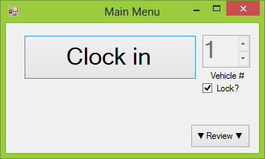
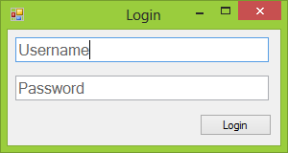
User View

Slide 13
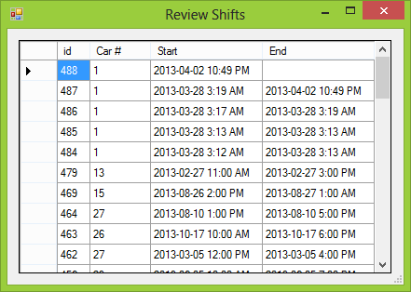
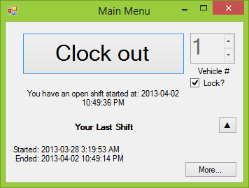
User View

Slide 14
Login
Simplistic
Minimized screen space with inline textbox identifiers
Ability to press enter on any text box to attempt a login

Slide 15
Clock in
Clock is a bigger button, larger font
Review button has arrows, conveying effect of action
Vehicle chooser is locked by default, reducing accidental changes

Slide 16
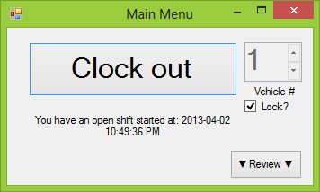
Clock out
Clock out replaces Clock in, reducing options
Current open shift details placed in whitespace underneath main function (Clock out)
Rest of user interface remains static

Slide 17
Inline review
Most pertinent information displayed inline
Opens functionality for more detail

Slide 18
Review shifts
Detailed view of shifts

Slide 19
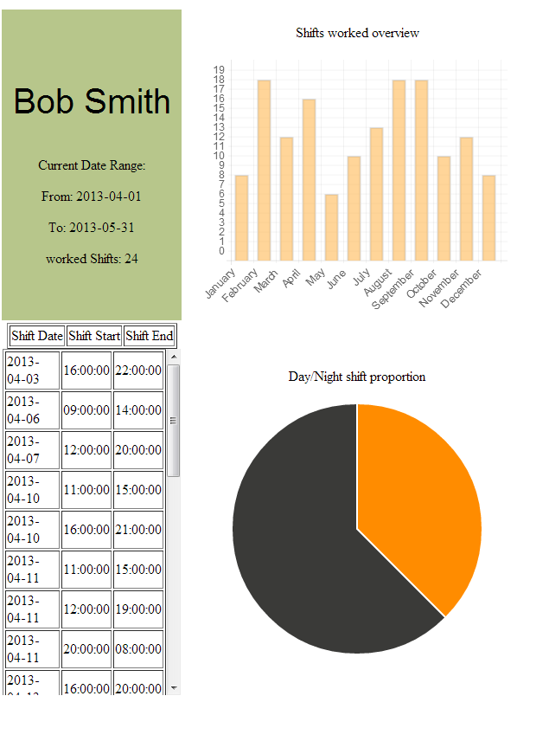
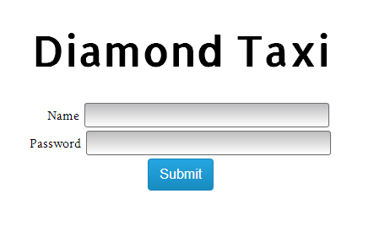
Administrator View

Slide 20
Login
Consistent simplicity between client and administrator view
Can only be accessed through the local network.
Stylistic features are somewhat eye-pleasing.

Slide 21
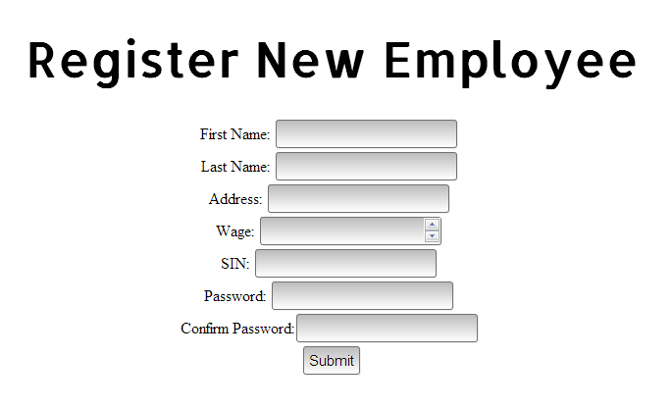
Registration
Straightforward
Validates on client-side
Validates on server-side
Creates new users in the database, which are immediately accessible.

Slide 22
Analytics
Clear, concise information
Easily selectable date ranges.
Offers Insights into shift patterns
Shows full list of shifts within selected range

Slide 23

Accessibility
Easily accessible from local network
Possible to access from outside the network if enabled and properly secured.

Slide 24
The Details

Slide 25








Technologies

Slide 26
User view
Written in C# on .NET 4.5
Windows Forms as the GUI Toolkit
Portable onto any computer that can use .NET 4.5
SQLite 3 as a database backend
Requires System.Data.SQLite.dll- a .NET library for managing SQLite databases

Slide 27
Secure.cs & Secure.py
Hashes all passwords on entry into the program- administrators nor database has access to unhashed passwords
Uses SHA-512 (generation SHA-2), giving secure hashing while maintain reasonably fast performance (99 MiB/s)
Does not salt hashes, so still vulnerable to rainbow table- however risk deemed low enough to be acceptable
Wonderfully simple! Built-in libraries provide readable code

Slide 28
DatabaseConnection.cs & dbinterface.py
Wrapper class for System.Data.SQLite & Sqlite3, respectively
Provides atomic queries and updates to the host table, cutting down on record locking
Uses parameterized SQL in order to avoid possibility of SQL injection attacks.

Slide 29
Web Client(Administrator View)
Written in Python 3.2.1
Using HTML5/CSS3/Jquery for the user interface
Accessible from any computer using a modern browser in the local network
SQLite 3 as a database backend, same as user view.
Requires bottle.py (Web server)
Requires Chart.js(Chart generation)
Supports multiple simultaneous users.

Slide 30
Webclient.py
Uses Bottle.py, a micro webserver framework, which actually hosts and serves the actual files.
Uses a templating system which returns pre-formatted HTML, and passes it variables to populate real-time data.
Handles all get/post requests.
Also does some small computations on data before it is passed on to the templates for visual representation(for example, it determines the ratio of day to night shifts)

Slide 31
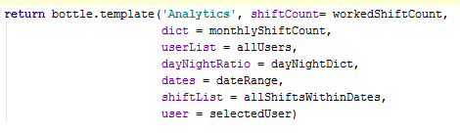
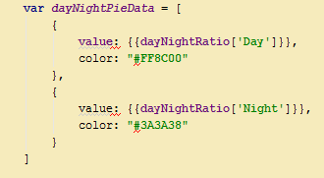
Templates
Webclient.py
Analytics.tpl

Slide 32
Populator.py
Generates 300 randomized records at a time in the T_SHIFTS table.

Slide 33
Version Control
Git implemented by GitHub
GitHub allowed the programmers to download, update, sync and merge the source
No worries about outdated source code
Automatic reversion history, rollback at any time
Issue creation and tracking
GitHub is great - use it

